Slide 1
Outlier?
Gradient/Slope
Confidence Interval
Intercept

Slide 2
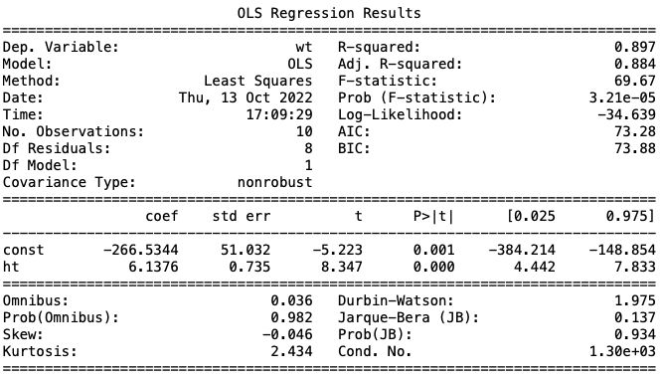

Slide 3
Residuals

Slide 4
Residuals

Slide 5
